Slide 1
MATERIAL OF THE EARTH’S CRUST
(ROCKS AND MINERALS)

Slide 2
THE LITHOSPHERE IS MADE UP OF ROCKS AND MINERALS. THEY INCLUDE NOT ONLY THE HARD MATERIALS SUCH AS GRANITE AND MARBLE, BUT ALSO SOFT AND LOOSE MATERIALS SUCH AS CHALK , CLAY,SAND AND SALT. ROCKS ARE MADE UP OF MINERALS. THEY DO NOT POSSESS A DEFINITE CHEMICAL COMPOSITION.

Slide 3
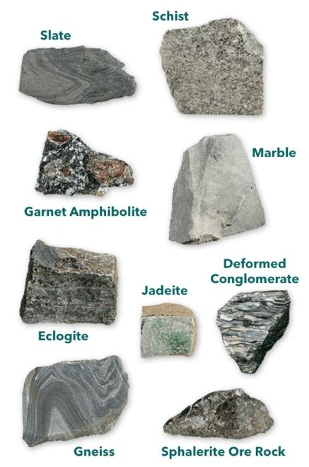
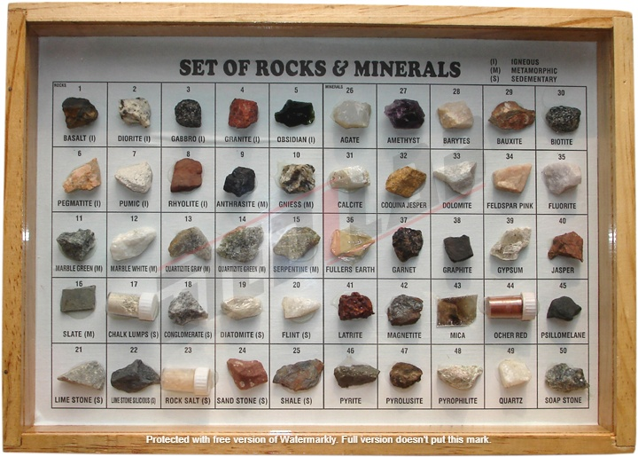
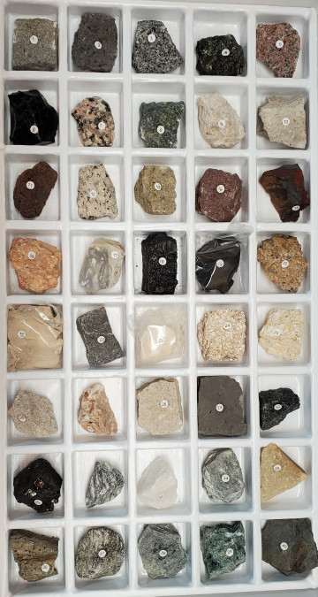

Slide 4
MINERALS ARE NATURALLY- OCCURRING SUBSTANCES PRESENT IN ROCKS. THESE ARE SOLID SUBSTANCE WHICH HAVE A DEFINITE CHEMICAL COMPOSITION. A ROCK IN WHICH A PARTICULAR MINERAL IS FOUND IN LARGE PERCENTAGE IS CALLED ORE

Slide 5
THANK YOU

